Slide 1

STAT-204
The Road to Chicken Dinner: An analysis of PUBG gameplay statistics
- Nistha Kumar & Utkarsh Gupta

Slide 2
Introduction
Goals
Analysis of the PUBG game statistics
Predicting winPlacePerc, matchType and some EDA
Contents
Approach
Challenges
Multiple Linear Regression & Logistic Regression
Dataset Imbalance & Independence

Slide 3
PART 01
Introduction
Analysis of PUBG game statistics

Slide 4


Background
Video Game that mimics Battle Royale.
Short Text Here
Click to Insert HeadingClick to Insert HeadingClick to Insert HeadingClick to Insert Heading, Click to Insert HeadingClick to Insert HeadingClick to Insert HeadingClick to Insert Heading Click to Insert HeadingClick to Insert HeadingClick to Insert HeadingClick to Insert Headingnibh lacus laoreet turpis, quis
100 players explore, scavenge, and eliminate each other on an empty island that shrinks over time.
Zone shrinks while player tries surviving to the end.
Strategies include hiding to victory or being the top fighter.

Slide 5
PART 02
Goals
Predicting winPlacePerc, matchType, and solving a few research-based problems

Slide 6

What we aim to achieve?
winPlacePerc
Gameplay strategies
Predict winPlacePerc response in range [0, 1], given all the attributes.
Impact of walking, swimming and riding on the response variable
Predict
Inference
Inference
Predict
Team Play Attributes
Match Type
Impact of team play attributes on the response variable.
A response variable with 6 categories

Slide 7
PART 03
Approach
Multiple Linear Regression and Logistic Regression

Slide 8
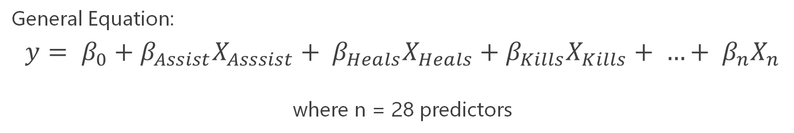
What we did?
Multiple Linear Regression
Forward Selection
Backward Elimination
Predict
General Equation:
$$y= β_{0}+β_{Assist}X_{Asssist}+ β_{Heals}X_{Heals}+β_{Kills}X_{Kills}+ …+ β_{n}X_{n}$$
where n = 28 predictors

Slide 9
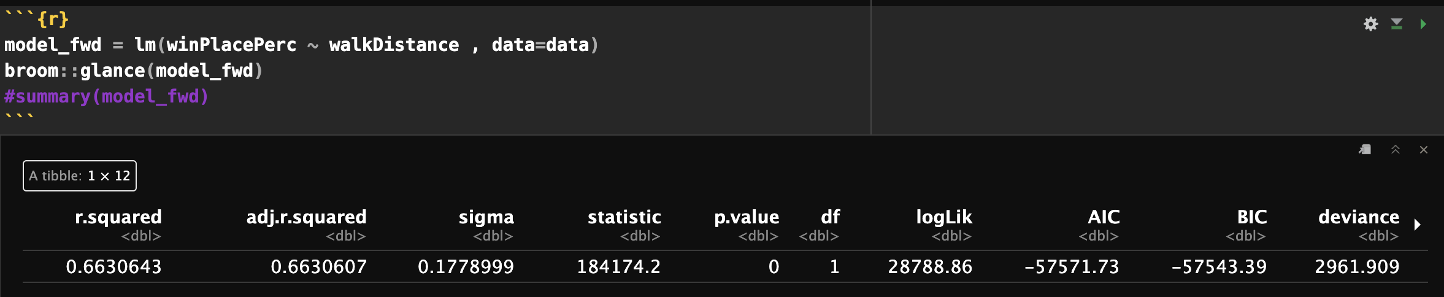
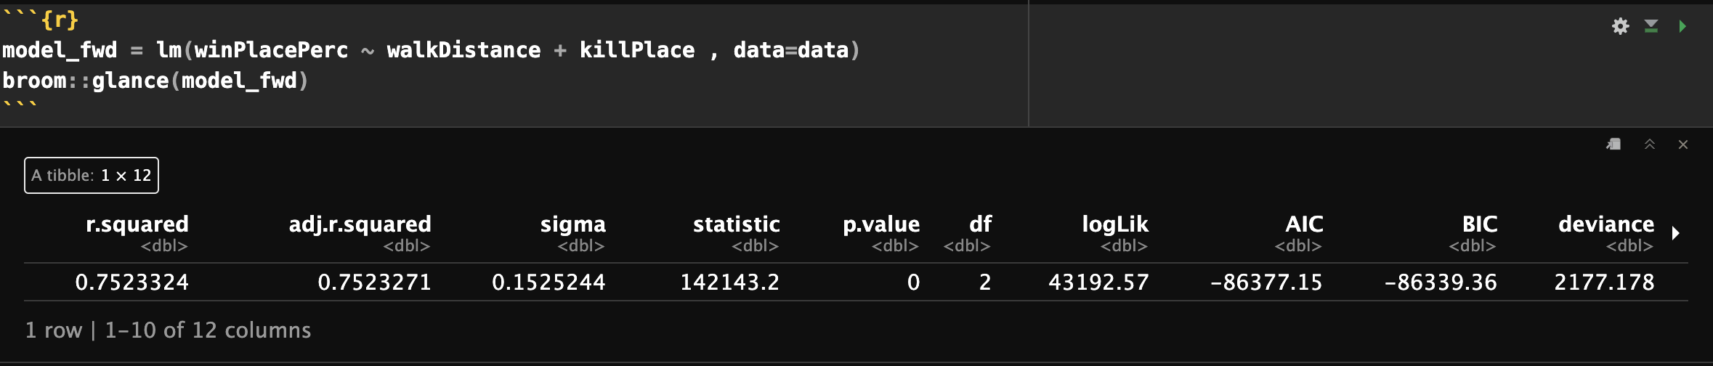
What we did?
Multiple Linear Regression
Forward Selection

Slide 10
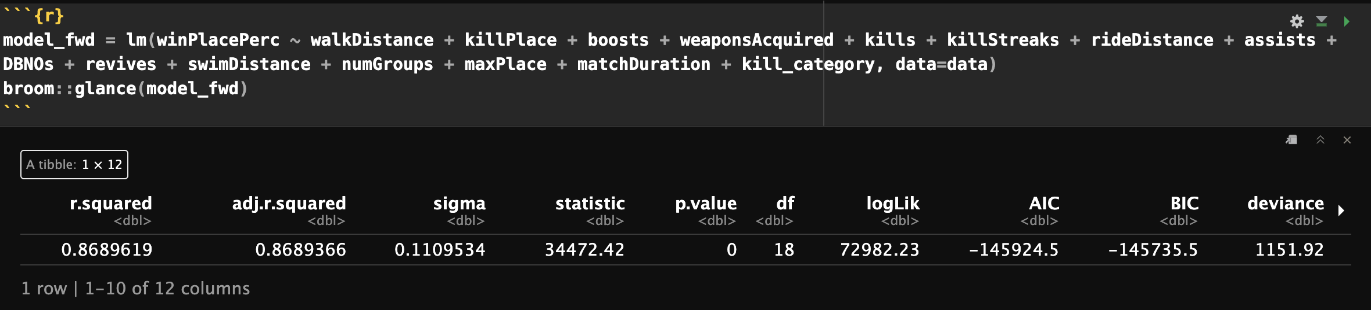
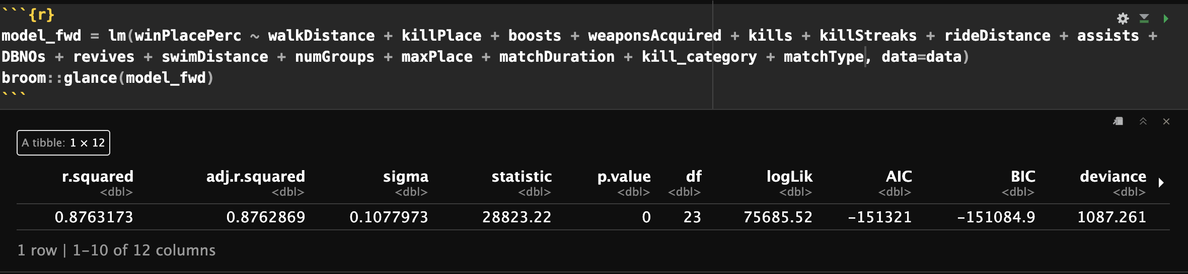
What we did?
Multiple Linear Regression
Forward Selection

Slide 11
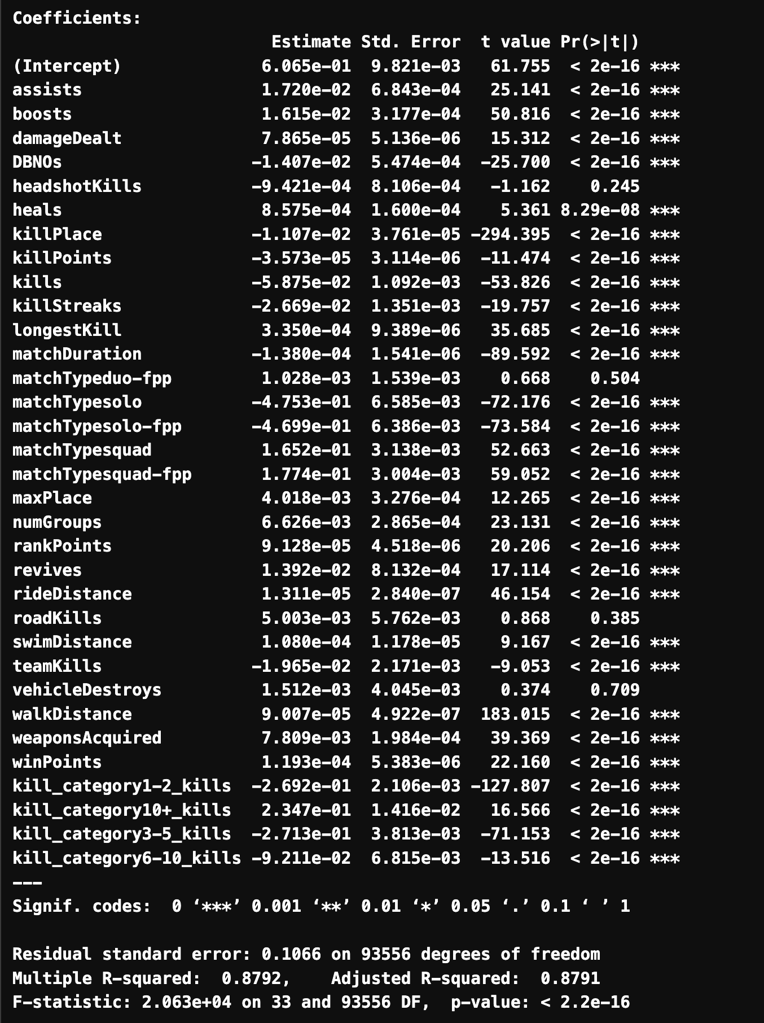

What we did?
Multiple Linear Regression
Backward Elimination

Slide 12
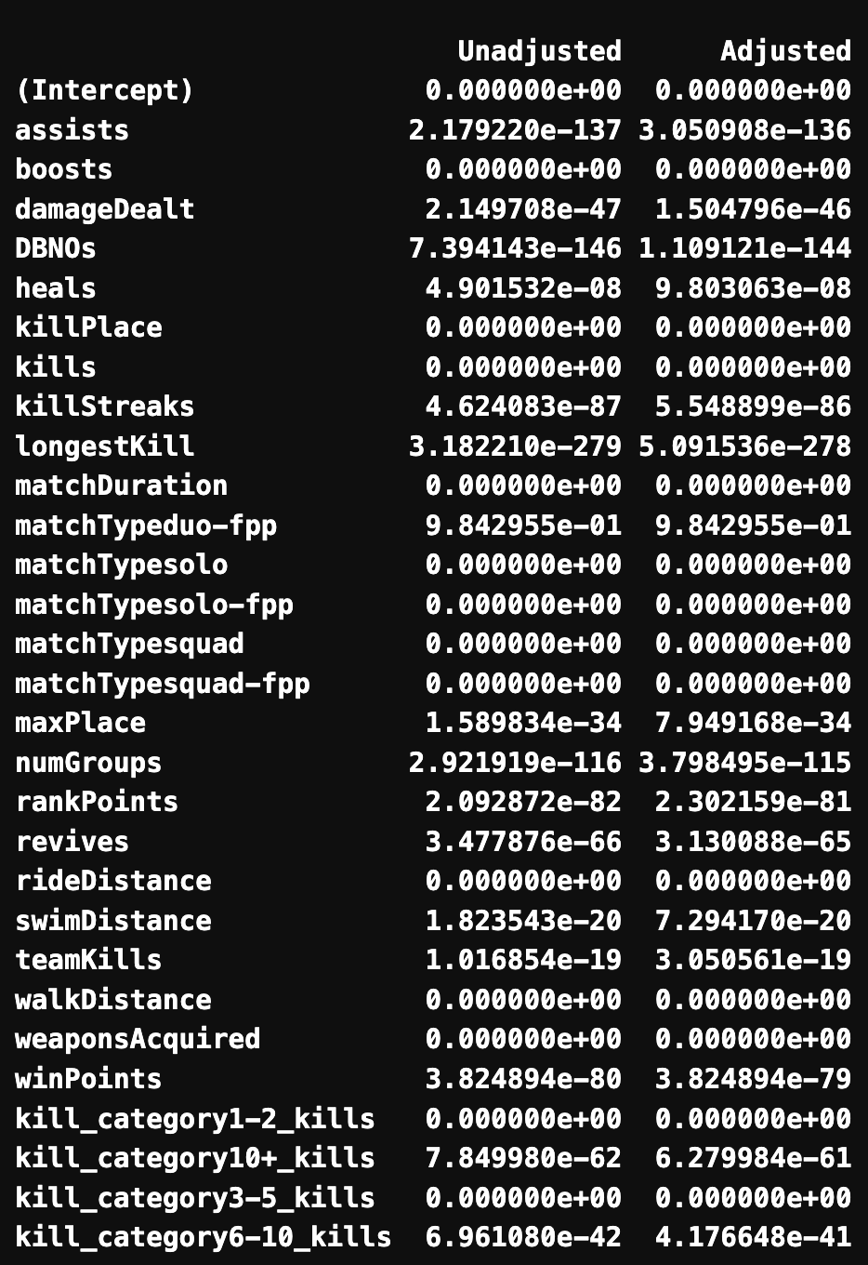
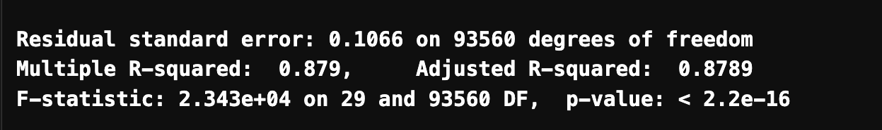
What we did?
Multiple Linear Regression
Dropping predictors as follows:
killPoints (Highly correlated with winPoints)
headShotKills, roadKills, vehicleDestroys (Least significant predictors)
p-value correction using Bonferonni adjustment
Backward Elimination

Slide 13
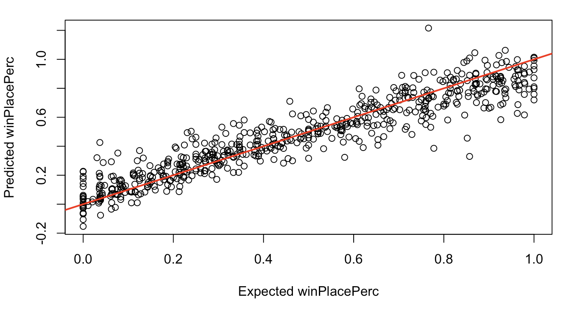
What we did?
Multiple Linear Regression
Predict
Mean Square Error | 0.0116

Slide 14
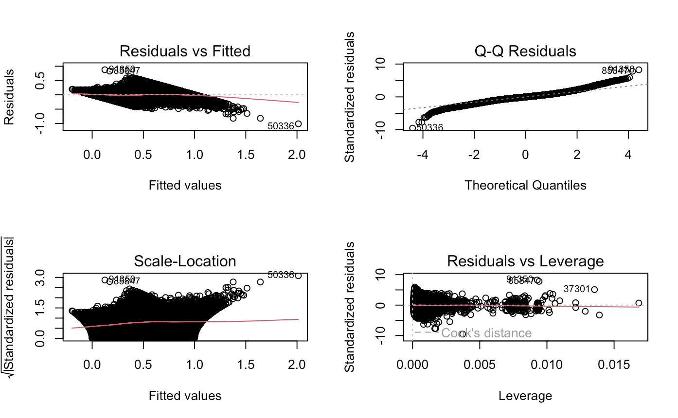
What we did?
Multiple Linear Regression
Predict
Mean Square Error | 0.0116

Slide 15
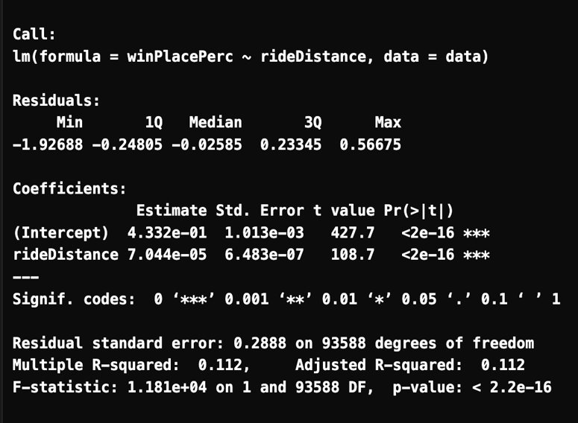
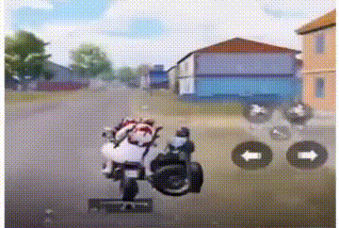
What we did?
Inference based on gameplay strategies
Understand the impact of gameplay strategies (walking, swimming, riding a car) on the response variable.

Slide 16
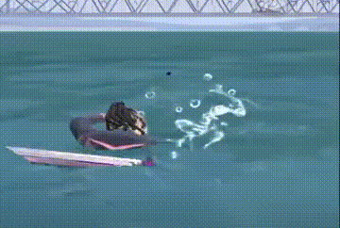
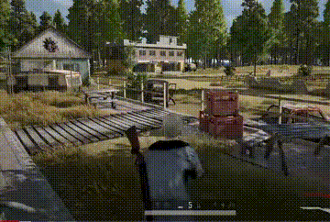
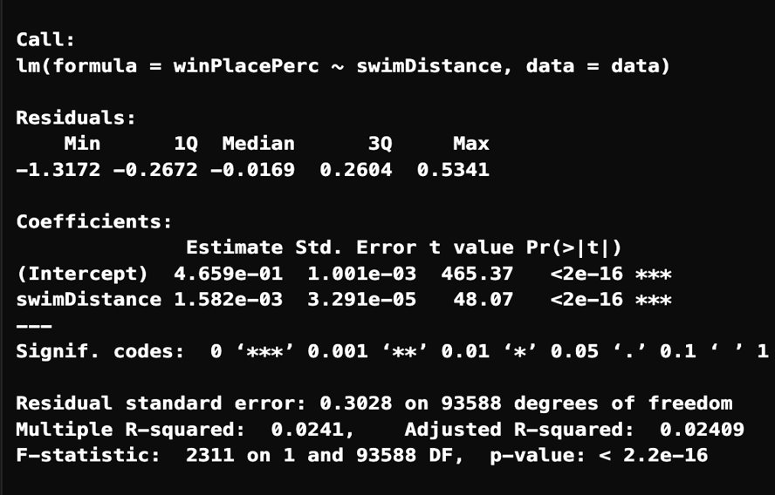
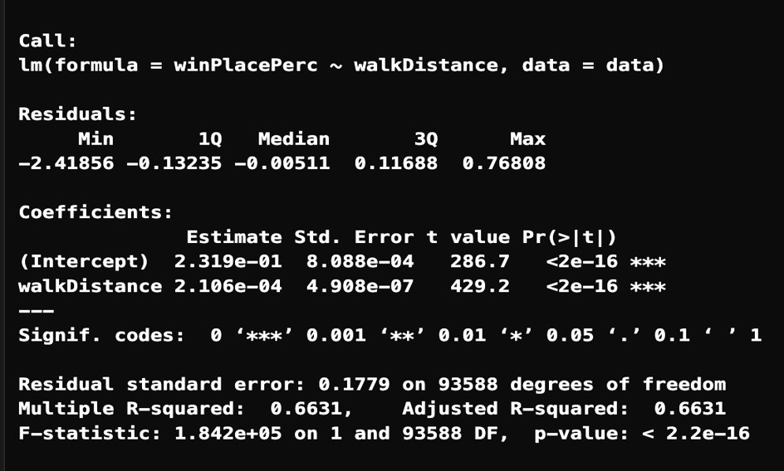
What we did?
Inference based on gameplay strategies

Slide 17
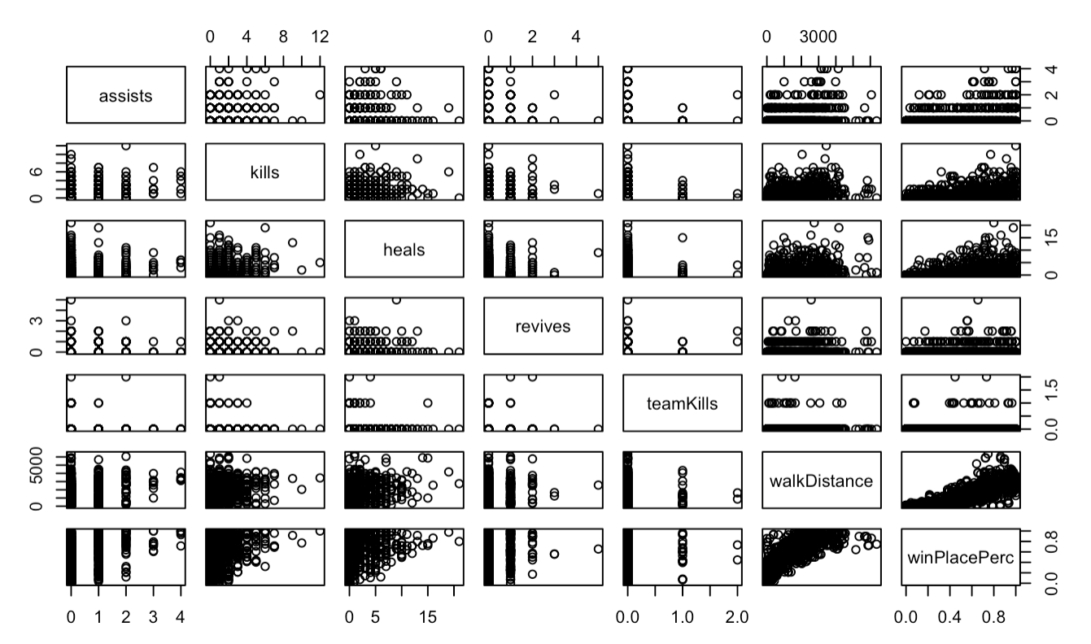
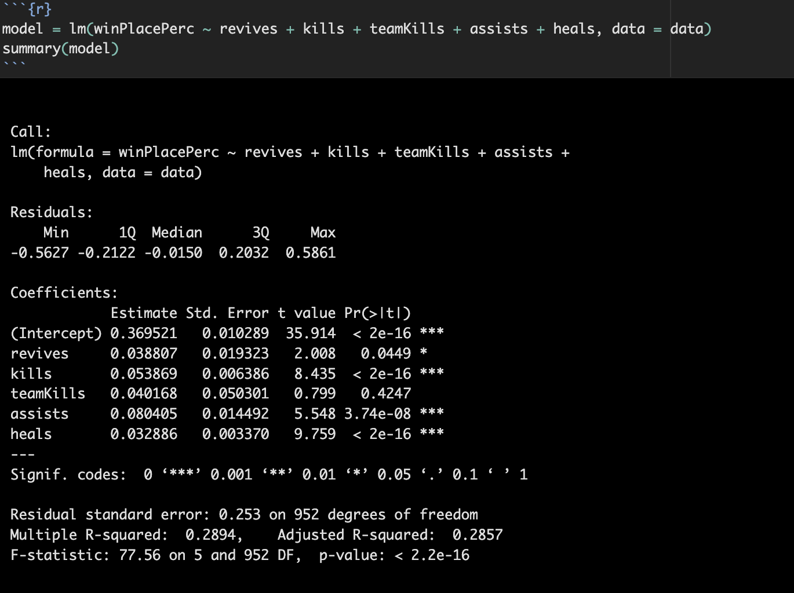
What we did?
Inference based on team play attributes

Slide 18
What we did?
Logistic Regression
Built a Test Set
Model fitting
Predict

Slide 19
What we did?
Logistic Regression
Created a test set such that every category has almost gotten 100 samples in it.
We took out only one player per match so that the following distribution of the data is extracted:
Built a Test Set
Match Type | Number of Test Observations
squad-fpp | 101
squad | 101
duo-fpp | 101
duo | 101
solo-fpp | 101
solo | 94
TOTAL | 599

Slide 20
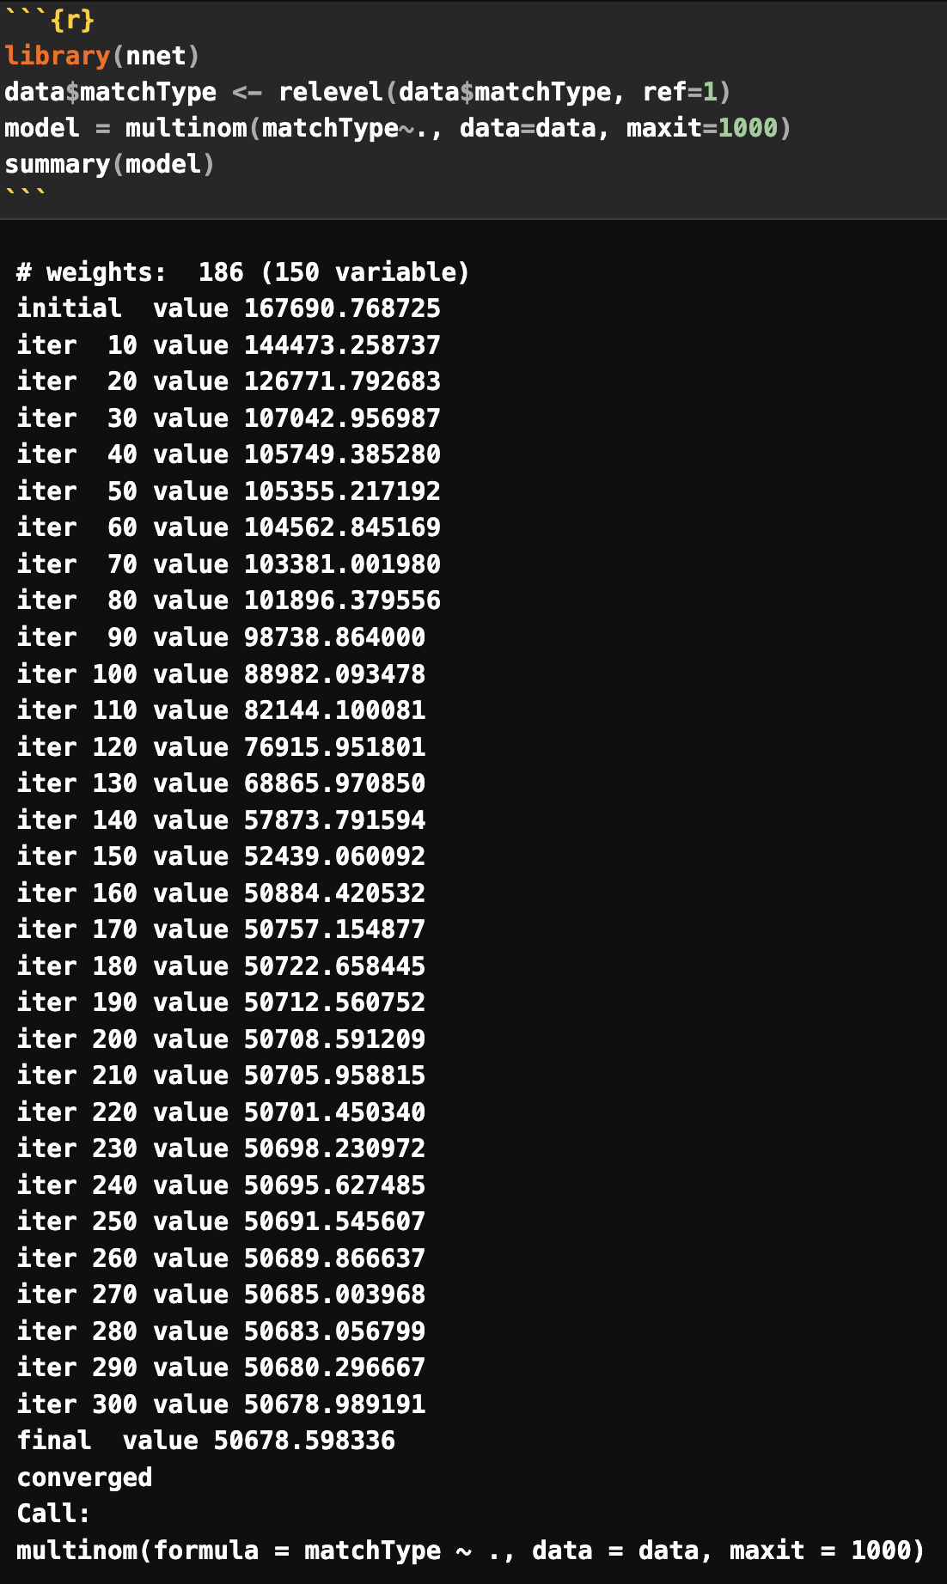
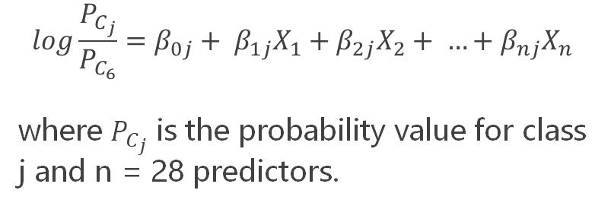
What we did?
Logistic Regression
$$log\frac{P_{C_{j}}}{P_{C_{6}}}=β_{0j}+ β_{1j}X_{1}+β_{2j}X_{2}+ …+β_{nj}X_{n}$$
where $P_{C_{j}}$ is the probability value for class j and n = 28 predictors.
Model fitting

Slide 21
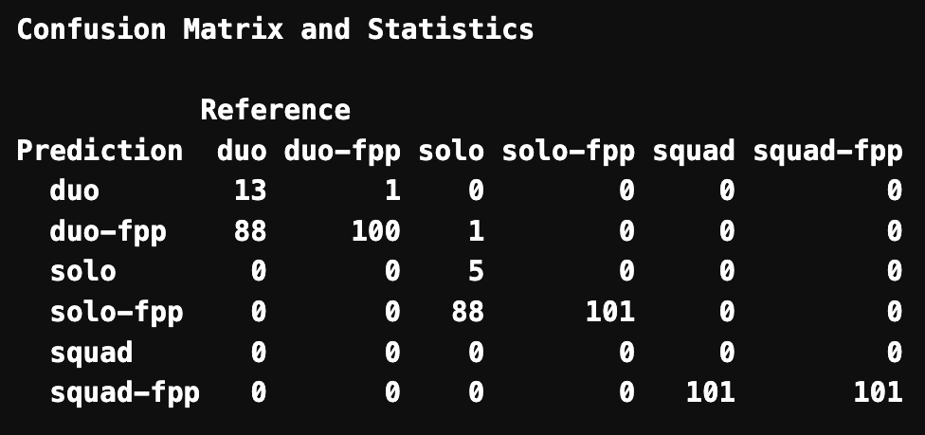
What we did?
Logistic Regression
Predict
Accuracy | 53.42%

Slide 22
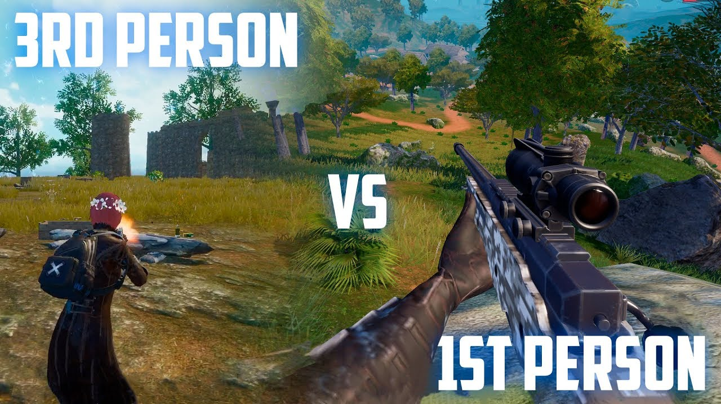
What we did?
Logistic Regression
Predict

Slide 23
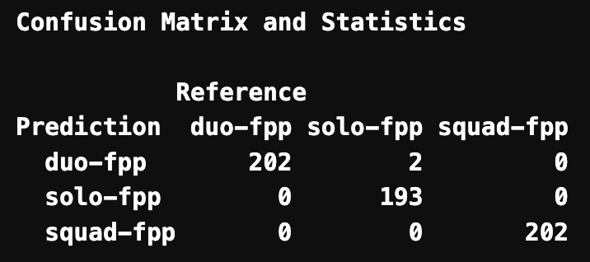
What we did?
Logistic Regression
Predict
Accuracy | 99.67%

Slide 24
PART 04
Challenges
Dataset Imbalance & Data Independence

Slide 25
Difficulties faced?
Dataset preparation
Training:
4.5M rows with 28 predictors to 100K rows
Testing:
Extracting only one player from different matches
Ensures that the test set represents the whole dataset
Dataset independence
Class Imbalance
Balanced out rows with 0 kills.

Slide 26
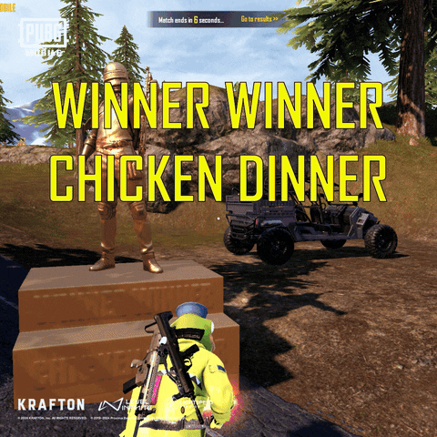
Thank You

